Slide 1
Software Process Model

Slide 2
What is a Process … ?
When we provide a service or create a product we always follow a sequence of steps to accomplish a set of tasks
You do not usually
put up the drywall before the wiring for a house is installed or
bake a cake before all the ingredients are mixed together
We can think of a series of activities as a process
Any process has the following characteristics
It prescribes all of the major activities
It uses resources and produces intermediate and final products
It may include sub-processes and has entry and exit criteria
The activities are organized in a sequence
Constrains or control may apply to activities
(budget control, availability of resources )

Slide 3
Software Processes
When the process involves the building of some product we refer to the process as a life cycle
Software development process – software life cycle
Coherent sets of activities for
Specifying,
Designing,
Implementing and
Testing software systems

Slide 4
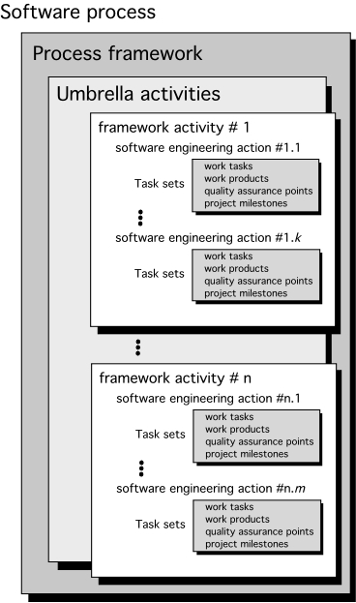
A Generic Process Model

Slide 5
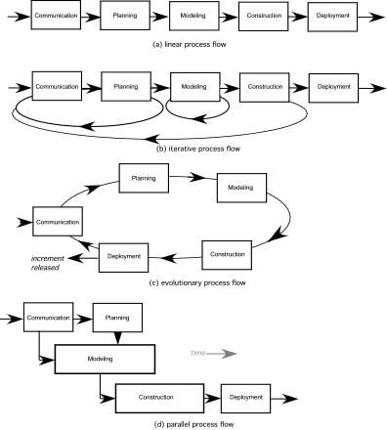
Process Flow

Slide 6
The software process
A structured set of activities required to develop a software system
Specification;
Design;
Validation;
Evolution.
A software process model is an abstract representation of a process. It presents a description of a process from some particular perspective.

Slide 7
Generic software process models
The waterfall model
Separate and distinct phases of specification and development.
Evolutionary development
Specification, development and validation are interleaved.
Component-based software engineering
The system is assembled from existing components.
There are many variants of these models e.g. formal development where a waterfall-like process is used but the specification is a formal specification that is refined through several stages to an implementable design.

Slide 8
Prescriptive Models
Prescriptive process models advocate an orderly approach to software engineering
That leads to a few questions …
If prescriptive process models strive for structure and order, are they inappropriate for a software world that thrives on change?
Yet, if we reject traditional process models (and the order they imply) and replace them with something less structured, do we make it impossible to achieve coordination and coherence in software work?

Slide 9
The Waterfall Model

Slide 10
Waterfall model

Slide 11
Waterfall model phases
Requirements analysis and definition
System and software design
Implementation and unit testing
Integration and system testing
Operation and maintenance
The drawback of the waterfall model is the difficulty of accommodating change after the process is underway

Slide 12
Waterfall model problems
Inflexible partitioning of the project into distinct stages
This makes it difficult to respond to changing customer requirements
Therefore, this model is only appropriate when the requirements are well-understood
Waterfall model describes a process of stepwise refinement
Based on hardware engineering models
Widely used in military and aerospace
industries

Slide 13
Why Not a Waterfall
But software is different :
No fabrication step
Program code is another design level
Hence, no “commit” step – software can always be changed…!
No body of experience for design analysis (yet)
Most analysis (testing) is done on program code
Hence, problems not detected until late in the process
Waterfall model takes a static view of requirements
Ignore changing needs
Lack of user involvement once specification is written
Unrealistic separation of specification from the design
Doesn’t accommodate prototyping, reuse, etc

Slide 14
Waterfall model problems
Inflexible partitioning of the project into distinct stages makes it difficult to respond to changing customer requirements.
Therefore, this model is only appropriate when the requirements are well-understood and changes will be fairly limited during the design process.
Few business systems have stable requirements.
The waterfall model is mostly used for large systems engineering projects where a system is developed at several sites.

Slide 15
Waterfall Advantages
Natural approach for problem solving
Conceptually simple, cleanly divides the problem into distinct independent phases
Easy to administer in a contractual setup – each phase is a milestone

Slide 16
Waterfall disadvantages
Assumes that requirements can be specified and frozen early
May fix hardware and other technologies too early
Follows the “big bang” approach – all or nothing delivery; too risky
Very document oriented, requiring docs at the end of each phase

Slide 17
Waterfall Usage
Well suited for projects where requirements can be understood easily and technology decisions are easy
Has been used widely
For standard/familiar type of projects it still may be the most optimum
Well suited to the out sourcing model

Slide 18
Evolutionary development
Exploratory development
Objective is to work with customers and to evolve a final system from an initial outline specification.
Should start with well-understood requirements.
The system evolves by adding new features as they are proposed by customer.
Throw-away prototyping
Objective is to understand the system requirements. Should start with poorly understood requirements
Develop “quick and dirty” system quickly;
Expose to user comment;
Refine;
Until adequate system developed.
Particularly suitable where:
detailed requirements not possible;
powerful development tools (e.g. GUI) available

Slide 19
Evolutionary development

Slide 20
Evolutionary development
Problems
Lack of process visibility
Systems are often poorly structured
Special skills (e.g. in languages for rapid prototyping) may be required
Applicability
For small or medium-size interactive systems
For parts of large systems (e.g. the user interface)
For short-lifetime systems

Slide 21
Evolutionary Models Prototyping
Addresses the requirement specification limitation of waterfall
Instead of freezing requirements only by discussions, a prototype is built to understand the requirements
Helps alleviate the requirements risk
A small waterfall model replaces the requirements stage

Slide 22
Evolutionary Models Prototyping
Quick
plan
communication
Modeling
Quick design
Deployment
delivery &
feedback
Construction
of prototype
Construction
of prototype

Slide 23
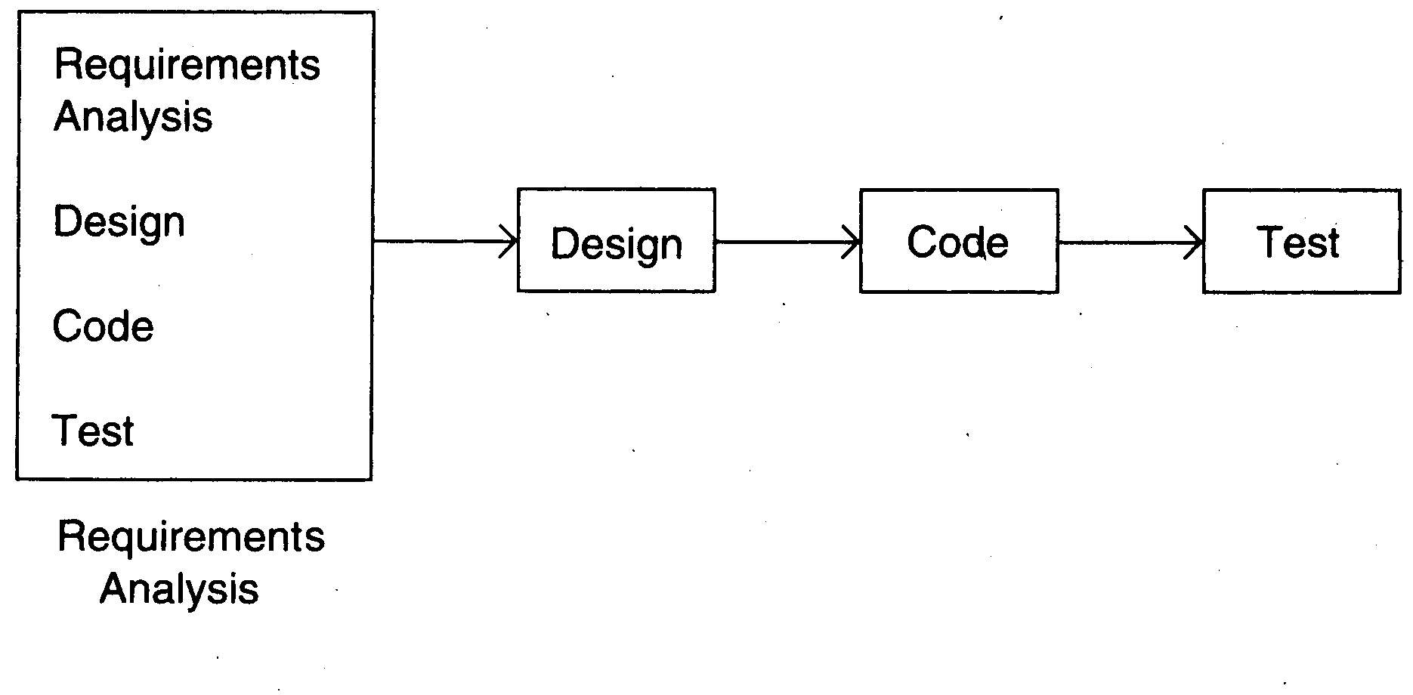
Prototyping

Slide 24
Development of prototype
Starts with initial requirements
Only key features which need better understanding are included in prototype
No point in including those features that are well understood
Feedback from users taken to improve the understanding of the requirements

Slide 25
Prototyping
Cost can be kept low
Build only features needing clarification
“quick and dirty” – quality not important, scripting etc can be used
Things like exception handling, recovery, standards are omitted
Cost can be a few % of the total
Learning in prototype building will help in building, besides improved requirements

Slide 26
Prototyping
Advantages
Requirement will be more stable and more likely to satisfy user needs
Early opportunity to explore scale/performance issues
Ability to modify or cancel the project early
Enhanced user engagement
Disadvantages:
Potential hit on cost and schedule
Potential false sense of security if prototype does not focus on key (high risk) issues

Slide 27
Prototyping
Applicability:
When req are hard to elicit
When confidence in reqs is low
Where reqs are not well understood
When design is driven by user needs
Variants
Paper Prototypes
UI Prototypes
Technology Proving
Rapid Prototyping environments

Slide 28
Iterative Development
Counters the “all or nothing” drawback of the waterfall model
Combines benefit of prototyping and waterfall
Develop and deliver software in increments
Each increment is complete in itself
Can be viewed as a sequence of mini-waterfalls
Feedback from one iteration is used in the future iterations

Slide 29
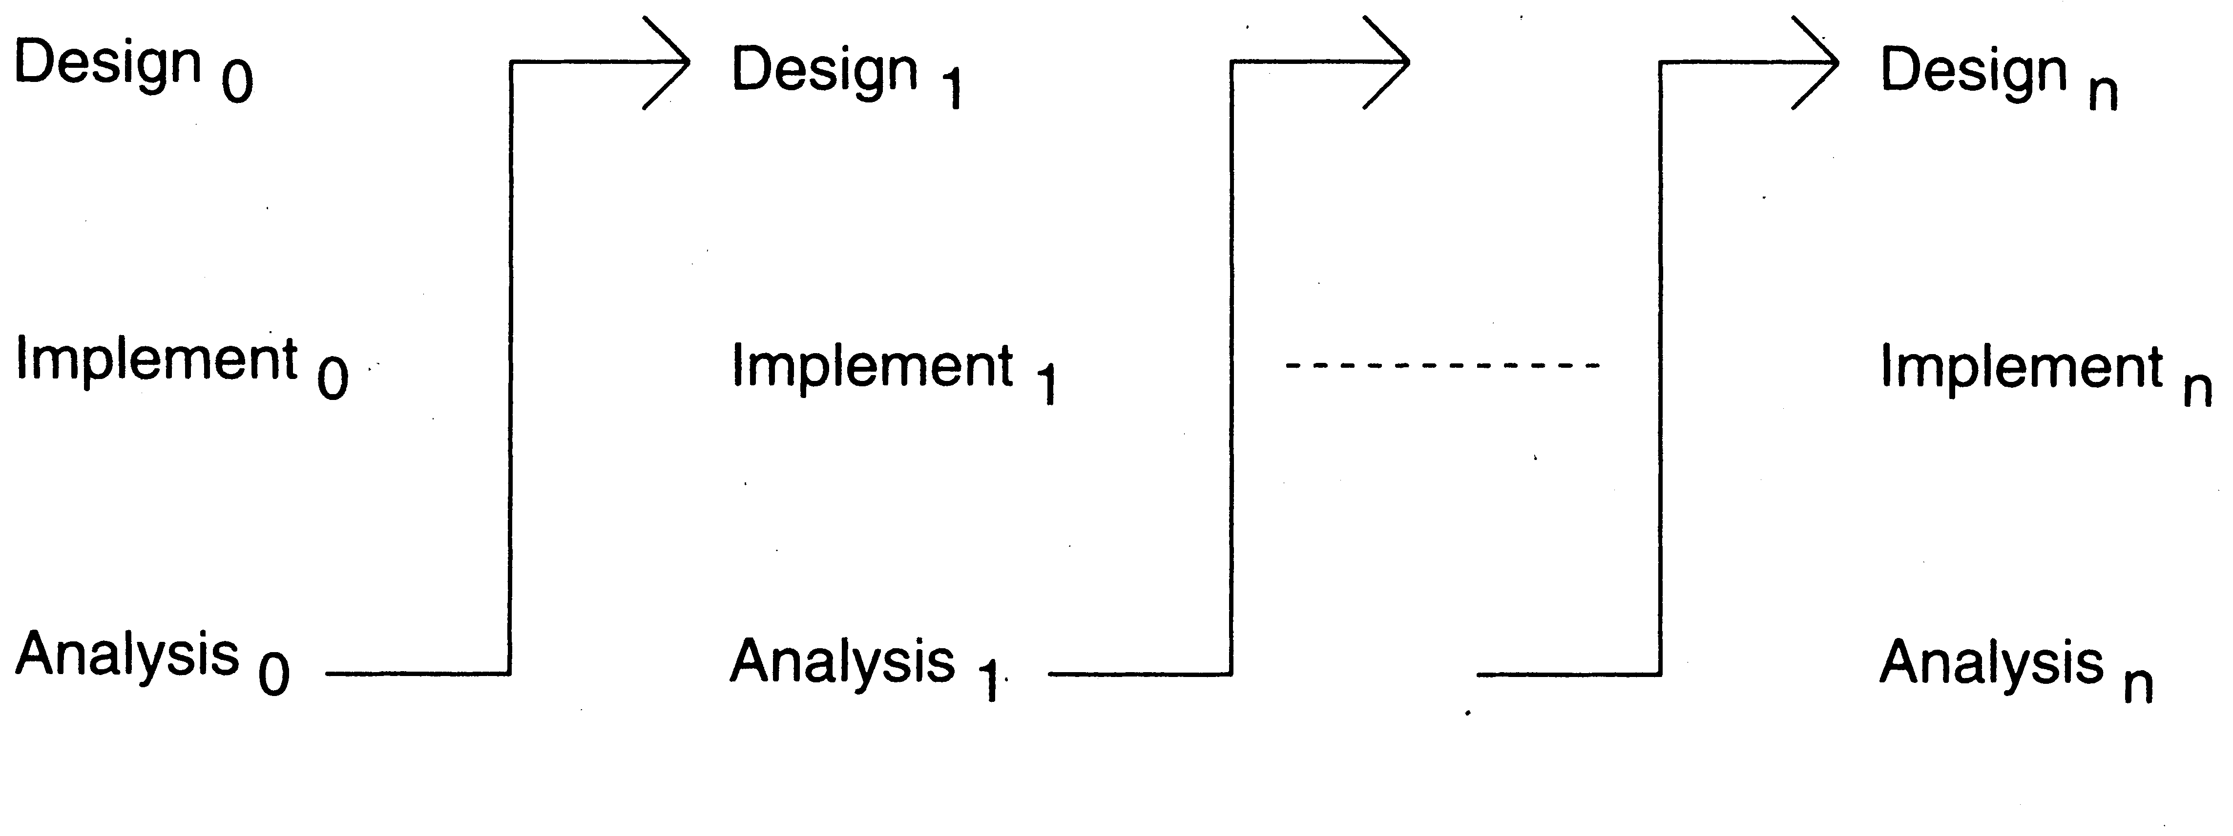
Iterative Enhancement

Slide 30
Iterative Development
Most Software Products follow it
Used commonly in customized development also
Businesses want quick response for sw
Cannot afford the risk of all-or-nothing
Newer approaches like XP, Agile,… all rely on iterative development

Slide 31
Iterative Development
Benefits
Get-as-you-pay
feedback for improvement
Drawbacks
Architecture/design may not be optimal
Amount of refactoring may increase
Total cost may increase

Slide 32
Iterative Development
Applicability
where response time is important,
risk of long projects cannot be taken,
all req not known
Execution
Each iteration is a mini waterfall – decide the specs, then plan the iteration
Length of iteration driven by amount of new functionality to be added in an iteration

Slide 33
Summary – waterfall
Strength | Weakness | Types of Projects
Simple Easy to execute Intuitive and logical Easy contractually | All or nothing – too risky Req frozen early May chose outdated hardware/tech Disallows changes No feedback from users Encourages req bloating | Well understood problems, short duration projects, automation of existing manual systems

Slide 34
Summary – Prototyping
Strength | Weakness | Types of Projects
Helps req elicitation Reduces risk Better and more stable final system | Front heavy Possibly higher cost and schedule Encourages req bloating Disallows later change | Systems with novice users; or areas with req uncertainity. Heavy reporting based systems can benefit from UI proto

Slide 35
Summary – Iterative
Strength | Weakness | Types of Projects
Regular deliveries, leading to biz benefit Can accommodate changes naturally Allows user feedback Avoids req bloating Naturally prioritizes req Allows reasonable exit points Reduces risks | Overhead of planning each iteration Total cost may increase System arch and design may suffer Rework may increase | For businesses where time is imp; risk of long projects cannot be taken; req not known and evolve with time

Slide 36
Process iteration
System requirements ALWAYS evolve in the course of a project so process iteration where earlier stages are reworked is always part of the process for large systems.
Iteration can be applied to any of the generic process models.
Two (related) approaches
Incremental delivery;
Spiral development.

Slide 37
Incremental delivery
Rather than deliver the system as a single delivery, the development and delivery is broken down into increments with each increment delivering part of the required functionality.
User requirements are prioritised and the highest priority requirements are included in early increments.
Once the development of an increment is started, the requirements are frozen though requirements for later increments can continue to evolve.

Slide 38
The Incremental Model

Slide 39
Incremental development

Slide 40
Incremental development advantages
Customer value can be delivered with each increment so system functionality is available earlier.
Early increments act as a prototype to help elicit requirements for later increments.
Lower risk of overall project failure.
The highest priority system services tend to receive the most testing.

Slide 41
Incremental means adding, Iterative means reworking (by Alistair Cockburn)
Incremental development is a staging and scheduling strategy in which the various parts of the system are developed at different times or rates and integrated as they are completed. The alternative is to develop the entire system with a big bang integration at the end.
Iterative development is a rework scheduling strategy in which time is set aside to revise and improve parts of the system. The alternative development is to get it right the first time (or at least declare that it is right!).
Increment | Iterate
fundamentally means “add onto”. | fundamentally means “change”.
repeating the process on a new section of work. | repeating the process on the same section of work
repeat the process (, design, implement, evaluate), | repeat the process (, design, implement, evaluate),

Slide 42
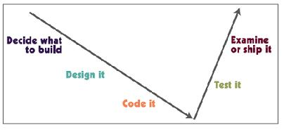
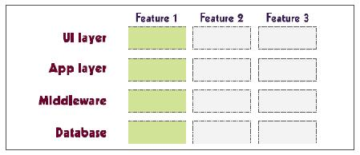
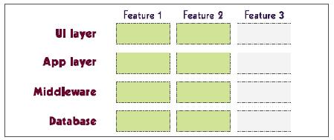
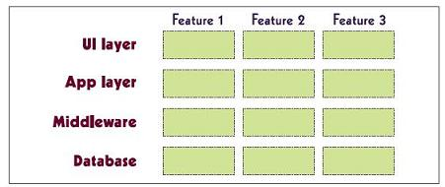
Incremental Development
The first increment delivers one slice of
functionality through the whole system.
The second increment delivers another
slice of functionality through the whole system.
The third increment delivers the rest of
the system

Slide 43
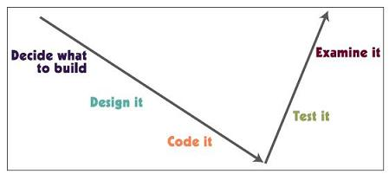
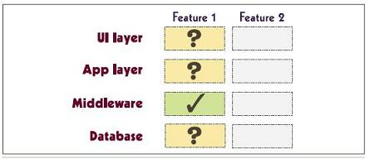
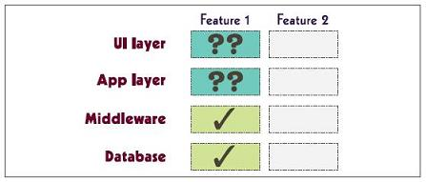
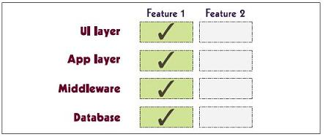
Iterative Development
\
The first iteration delivers enough of
feature 1 to evaluate what is correct
and what needs revision.
After the second iteration, some revised
parts still need improvement.
The third iteration produces the final
and stable feature

Slide 44
Incremental & Iterative - summary
Iterative model - This model iterates requirements, design, build and test phases again and again for each requirement and builds up a system iteratively till the system is completely build.
Incremental model - It is non integrated development model. This model divides work in chunks and one team can work on many chunks. It is more flexible.
Spiral model - This model uses series of prototypes in stages, the development ends when the prototypes are developed into functional system. It is flexible model and used for large and complicated projects.
Evolutionary model - It is more customer focused model. In this model the software is divided in small units which is delivered earlier to the customers.
V-Model - It is more focused on testing. For every phase some testing activity are done.

Slide 45
Spiral development
Process is represented as a spiral rather than as a sequence of activities with backtracking.
Each loop in the spiral represents a phase in the process.
No fixed phases such as specification or design - loops in the spiral are chosen depending on what is required.
Risks are explicitly assessed and resolved throughout the process.
This was the motivation behind developing the Spiral Model - Risk

Slide 46
Evolutionary Models: The Spiral

Slide 47
Spiral model of the software process

Slide 48
Spiral Model Basic Farmeworks
Communication
Software development process starts with communication between customer and developer.
Planning
It includes complete estimation and scheduling and risk analysis.
Modelling
It includes detail requirement analysis and project design.
Flowchats and UML Diagrams to show pictorial flow of process and programs.

Slide 49
Spiral Model Basic Farmeworks
Construction
Coding – Design details are implemented using appropriate programming language.
Testing – Testing is carried out by testing team.
Deployment
It includes software delivery, support and feedback from customer.
Note: After customer evaluation, next spiral implements customer’s suggestions plus enhancements plan.

Slide 50
Spiral model sectors
Objective setting
Specific objectives for the phase are identified.
Risk assessment and reduction
Risks are assessed and activities put in place to reduce the key risks.
Development and validation
A development model for the system is chosen which can be any of the generic models.
Planning
The project is reviewed and the next phase of the spiral is planned.

Slide 51
Spiral Model Usage
Spiral model has been very influential in helping people think about iteration in software processes and introducing the risk-driven approach to development.
In practice, however, the model is rarely used as published for practical software development.
Chapter 2 Software Processes
14

Slide 52
Advantages of Spiral Model
Software is produced early in the software life cycle.
Risk handling is one of important advantages of the Spiral model, it is best development model to follow due to the risk analysis and risk handling at every phase.
Flexibility in requirements. In this model, we can easily change requirements at later phases and can be incorporated accurately. Also, additional Functionality can be added at a later date.
It is good for large and complex projects.
It is good for customer satisfaction. We can involve customers in the development of products at early phase of the software development. Also, software is produced early in the software life cycle.

Slide 53
Advantages of Spiral Model continue…
Strong approval and documentation control.
It is suitable for high risk projects, where business needs may be unstable. A highly customized product can be developed using this.

Slide 54
Disadvantages of Spiral Model
It is not suitable for small projects as it is expensive.
It is much more complex than other SDLC models. Process is complex.
Too much dependable on Risk Analysis and requires highly specific expertise.
Difficulty in time management. As the number of phases is unknown at the start of the project, so time estimation is very difficult.
Spiral may go on indefinitely.
End of the project may not be known early.
It is not suitable for low risk projects.
May be hard to define objective, verifiable milestones. Large numbers of intermediate stages require excessive documentation.

Slide 55
Evolutionary Models: Concurrent

Slide 56
Concurrent development model
The concurrent development model is called as concurrent model.
The communication activity has completed in the first iteration and exits in the awaiting changes state.
The modeling activity completed its initial communication and then go to the underdevelopment state.
If the customer specifies the change in the requirement, then the modeling activity moves from the under development state into the awaiting change state.
The concurrent process model activities moving from one state to another state.

Slide 57
Advantages of the concurrent development model
This model is applicable to all types of software development processes.
It is easy for understanding and use.
It gives immediate feedback from testing.
It provides an accurate picture of the current state of a project.

Slide 58
Disadvantages of the concurrent development model
It needs better communication between the team members. This may not be achieved all the time.
It requires to remember the status of the different activities.

Slide 59
a) Differentiate in between waterfall and spiral model.

